Slide 1
Magma Magnetic Technologies Ltd

Slide 2
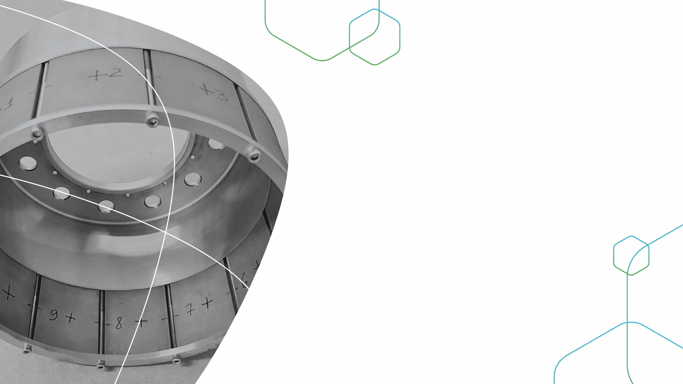
About Magma
Magma was founded in 1979 and quickly became a leading manufacturer of hard ferrite magnets.
Over the years, the company has developed its capabilities, and now supports a wide range of applications in many industrial fields.
We support our customers from the initial phase of simulation to the mass production stage.
Having known the magnet business for many years, our goal is to support our customers in solving any problems they encounter with the magnet component, including modification of other components that affect the magnetic field.
Looking forward to learning your needs, and taking a small part in making your big dreams come true.

Slide 3
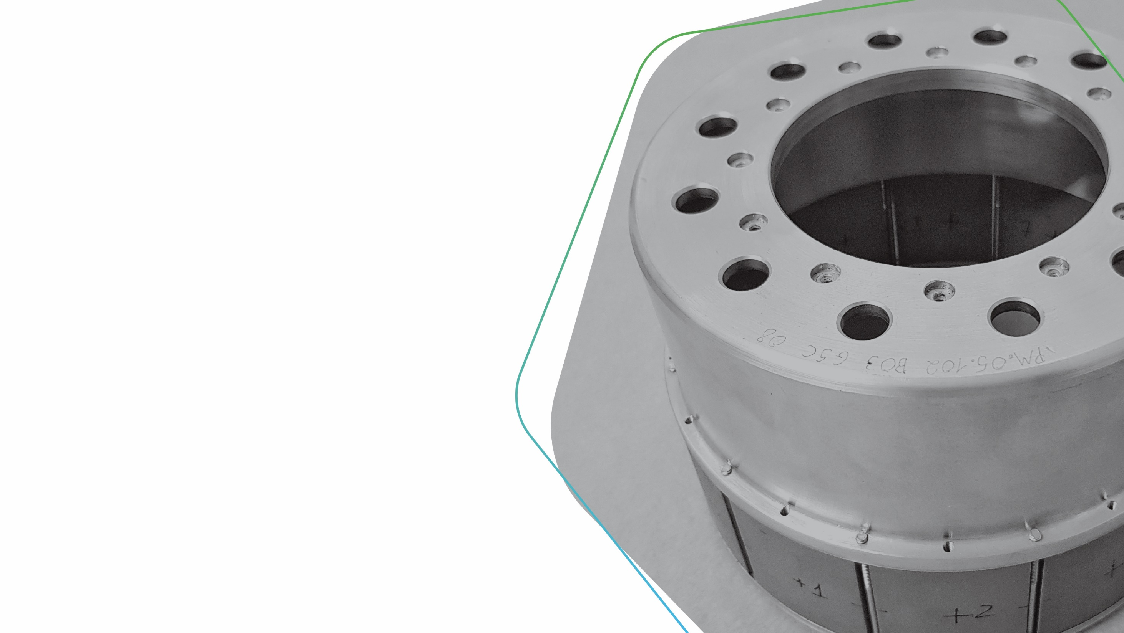
Biomedical
Green Energy
Homeland
Security
Magnetic Services
Automotive
Consumer
Goods

Slide 4
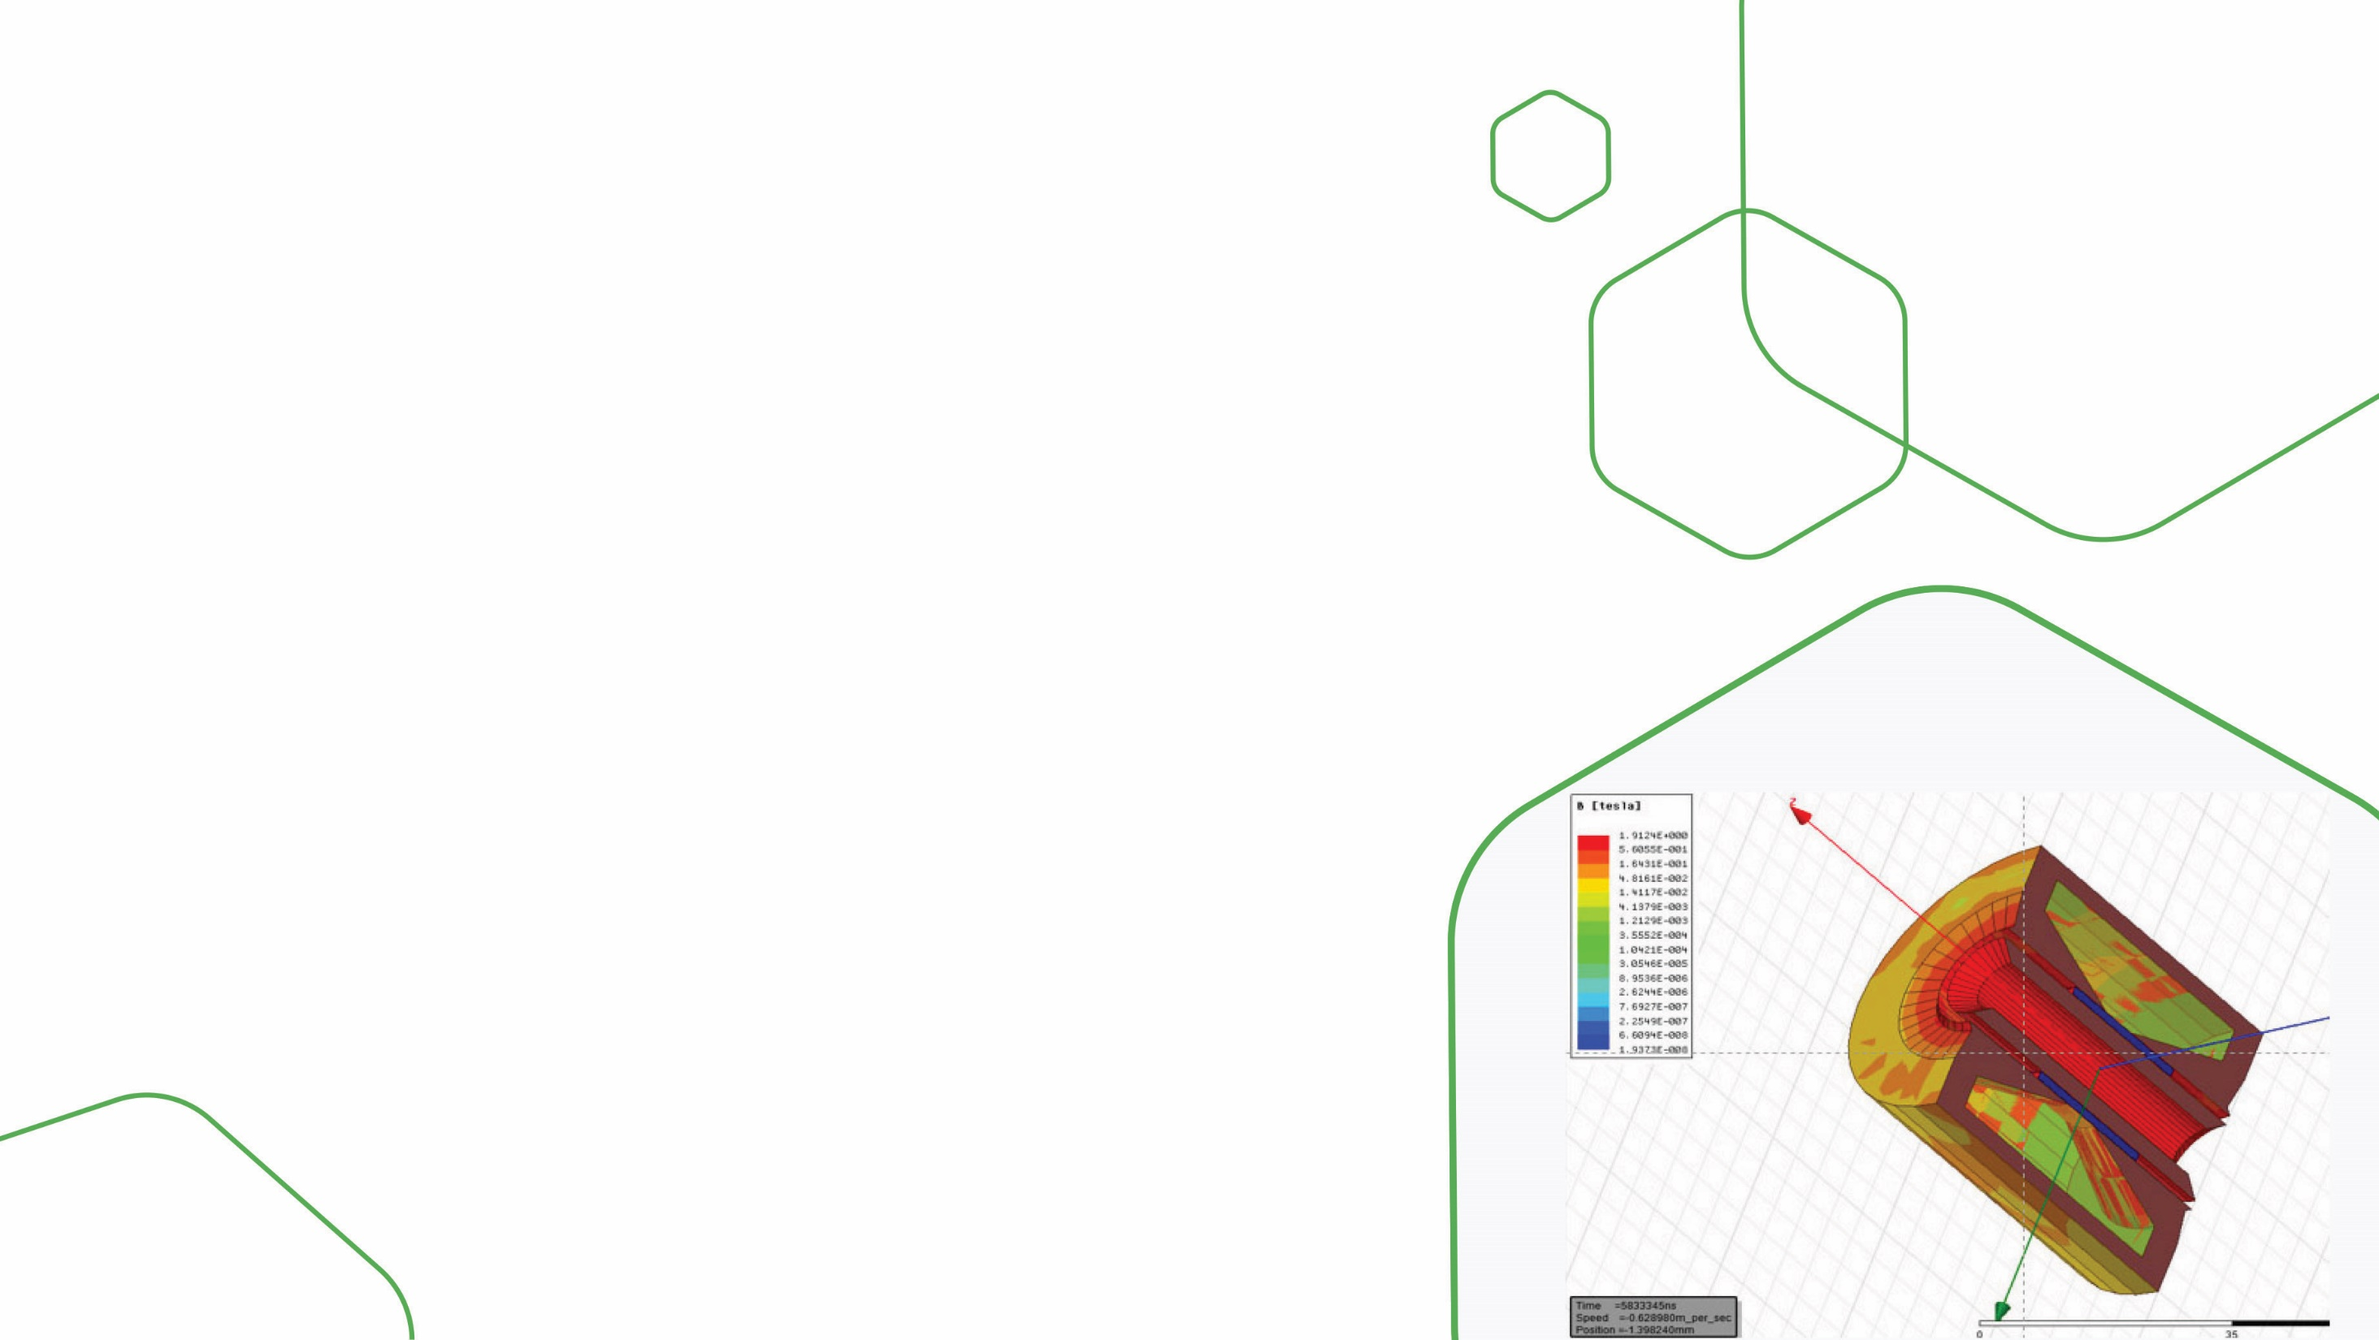
Magnetic services
With many years of experience including hundreds of successful projects, Magma supports its customers by performing accurate magnetic simulation using sophisticated magnetic software.
ANSYS MAXWELL

Slide 5
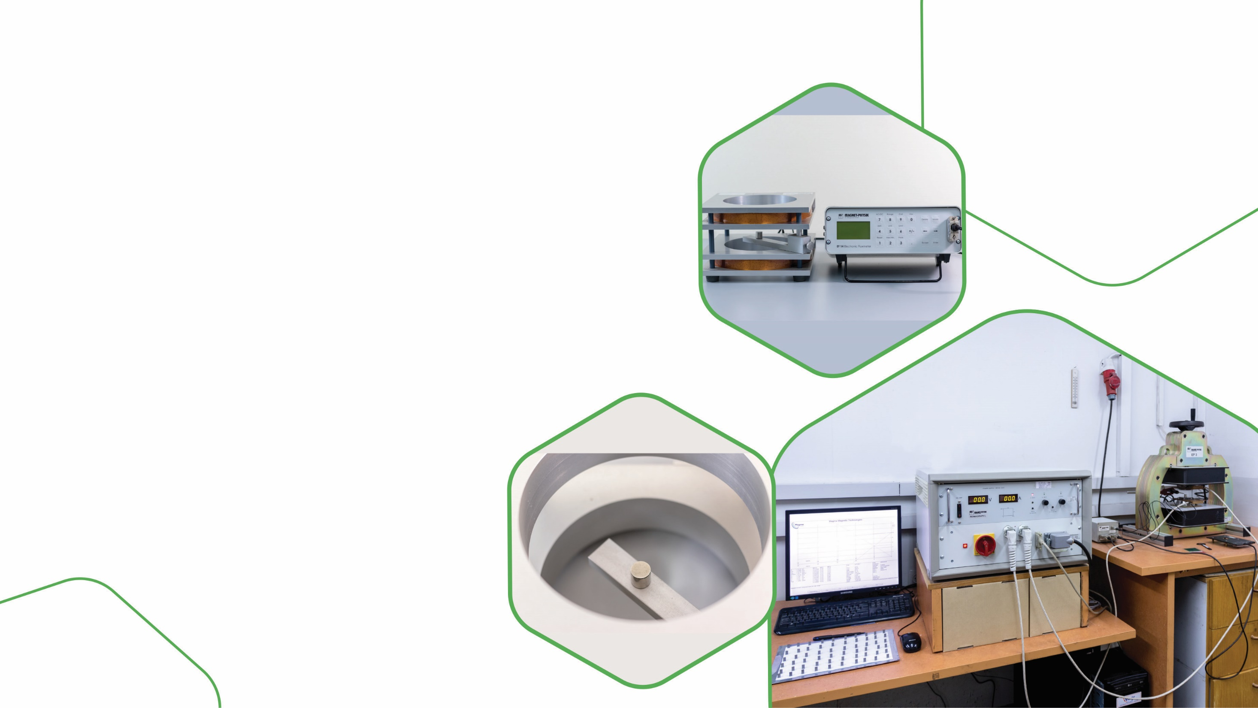
Magnetic services
With our advanced magnetic laboratory, we can ensure our customers consistent quality throughout the project’s lifespan.
In many projects, special test protocols are written to adapt our capabilities to the customer’s specific requirements.

Slide 6
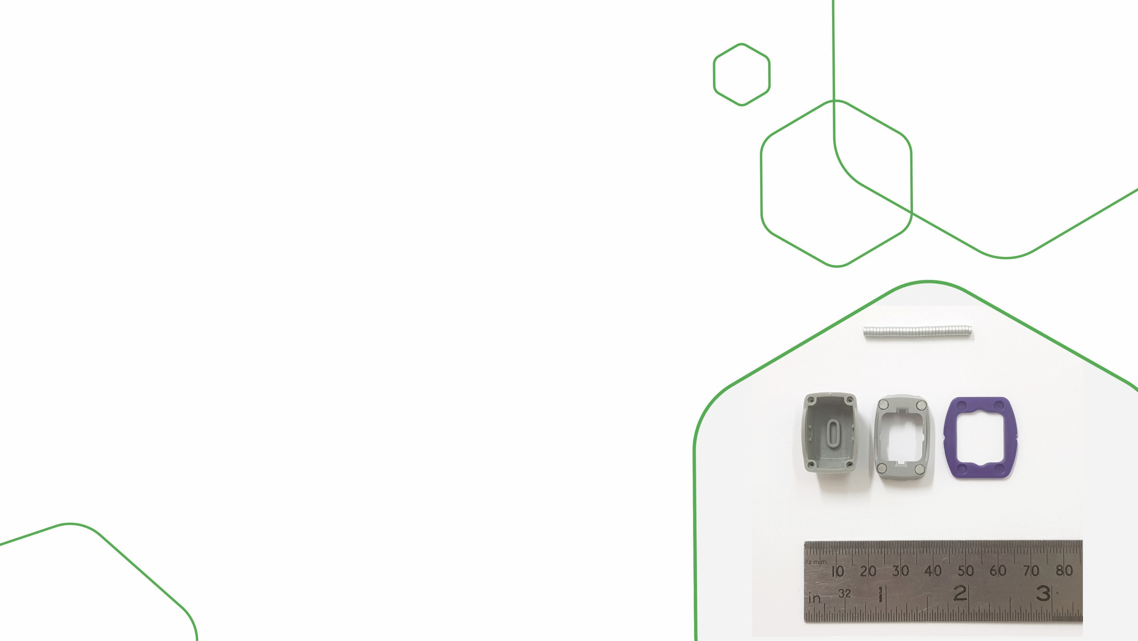
Biomedical
Customer 1
(Drug dispenser device)
Challenge: how to set up an economic assembly process for huge quantities of units in which very tiny magnets are inserted into plastic parts.
Solution: Magma developed an overmolding process, immediately followed by a magnetization process to the customer’s satisfaction.

Slide 7
Biomedical
Customer 2
(Drug administration device)
Challenge: customer was suffering from a high rejection rate of the final product.
Solution: Magma ran a sophisticated magnetic simulation which led to a change in both the magnet specifications and the metal part, thus solving the failure the customer encountered.

Slide 8
Green Energy
Customer 1
(Wind, wave, and hydroelectric energy)
Challenge: electricity generation by low-pressure water flow in third world countries.
Solution: Magma developed an efficient magnetic coupling that enabled the customer to complete his product development successfully.

Slide 9
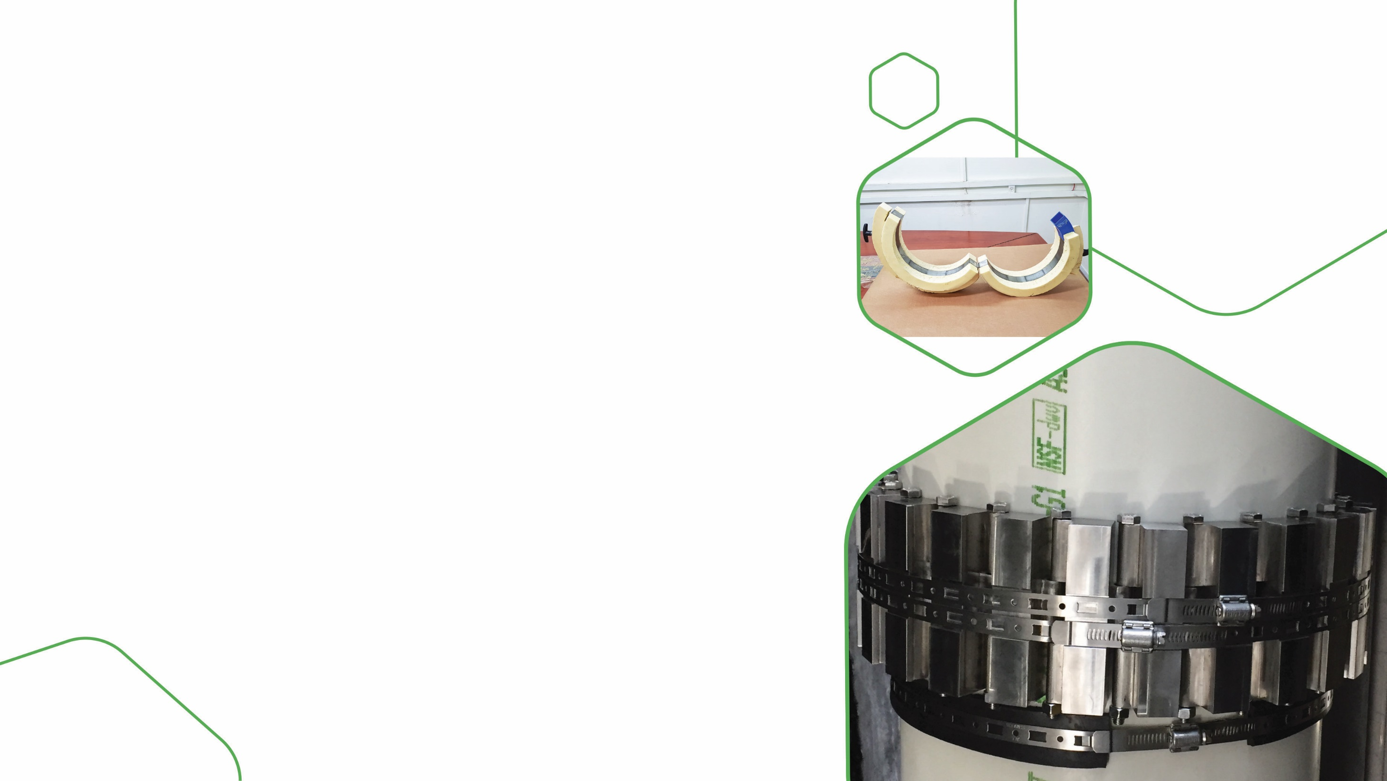
Green Energy
Customer 2
(Water treatment)
Challenge: to avoid scale in large diameter cooling tower pipes.
Solution: Special magnetic design based on the Halbach array, to obtain a maximal magnetic field in a large diameter (12”) magnetic assembly, involving the use of laser welding.

Slide 10
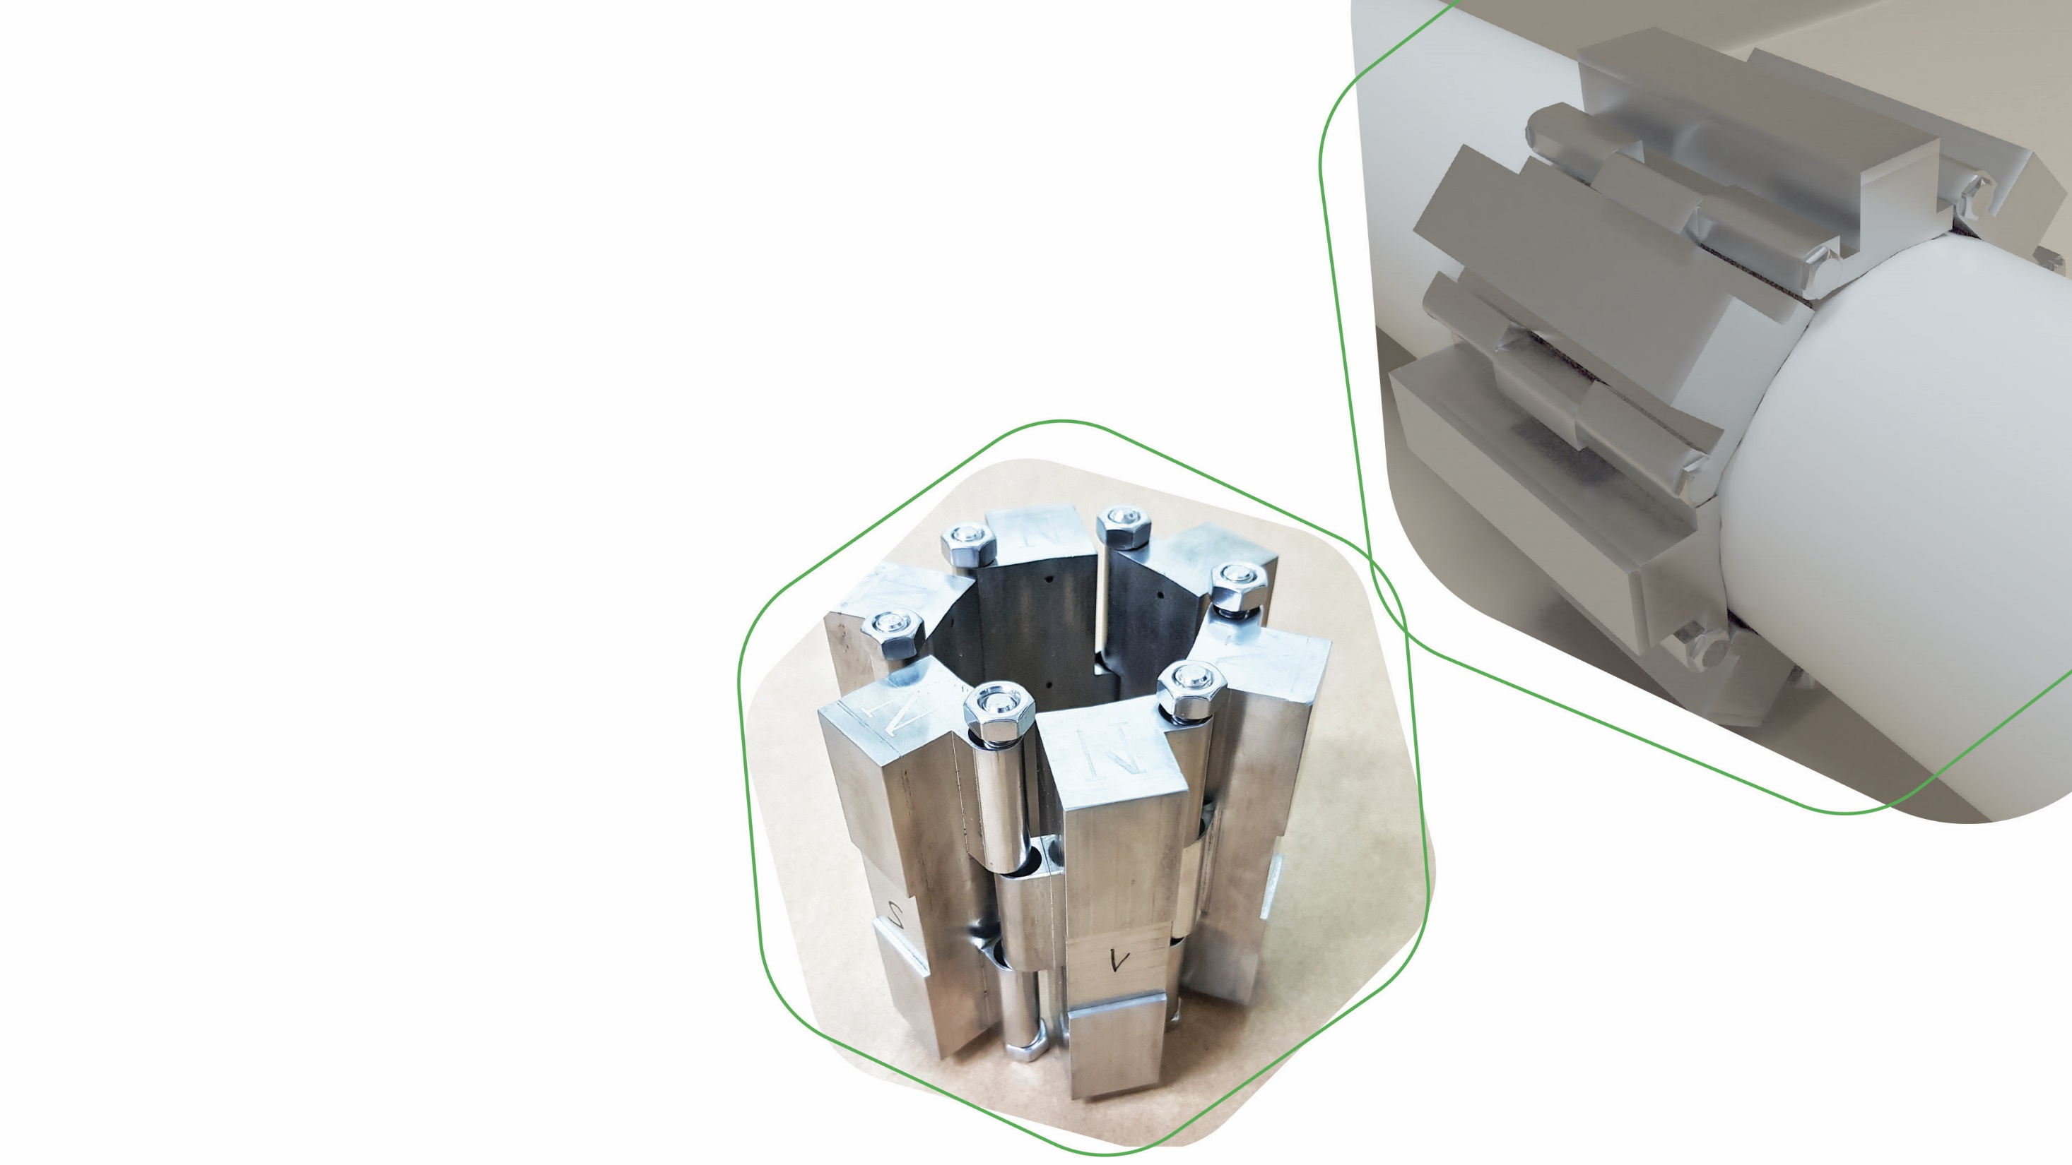
Looking for a strategic
partner?
For example: in this project, Magma became a significant partner of Hydroflux:
www.hydroflux.com

Slide 11
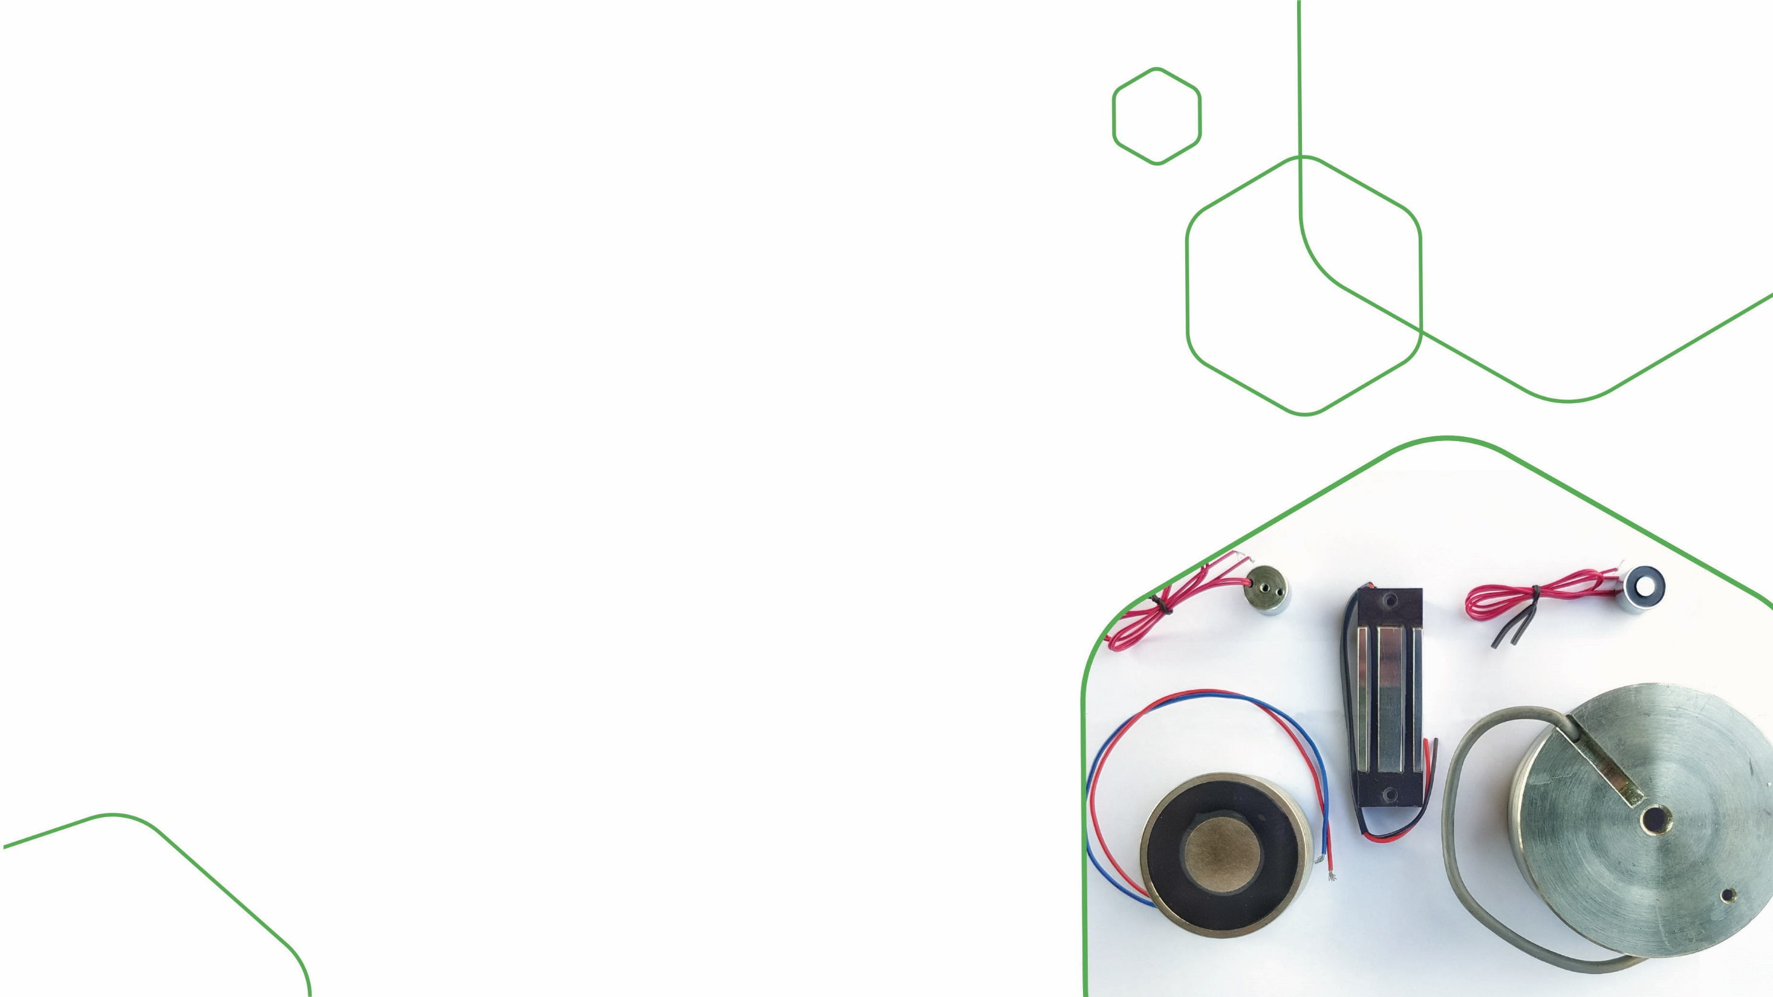
Homeland
Security
Customer 1
Challenge: possibility of connecting a device under seawater, in harsh and corrosive environmental conditions.
Solution: Magma developed a uniquely designed electromagnet with a specific metallic structure and cables.

Slide 12
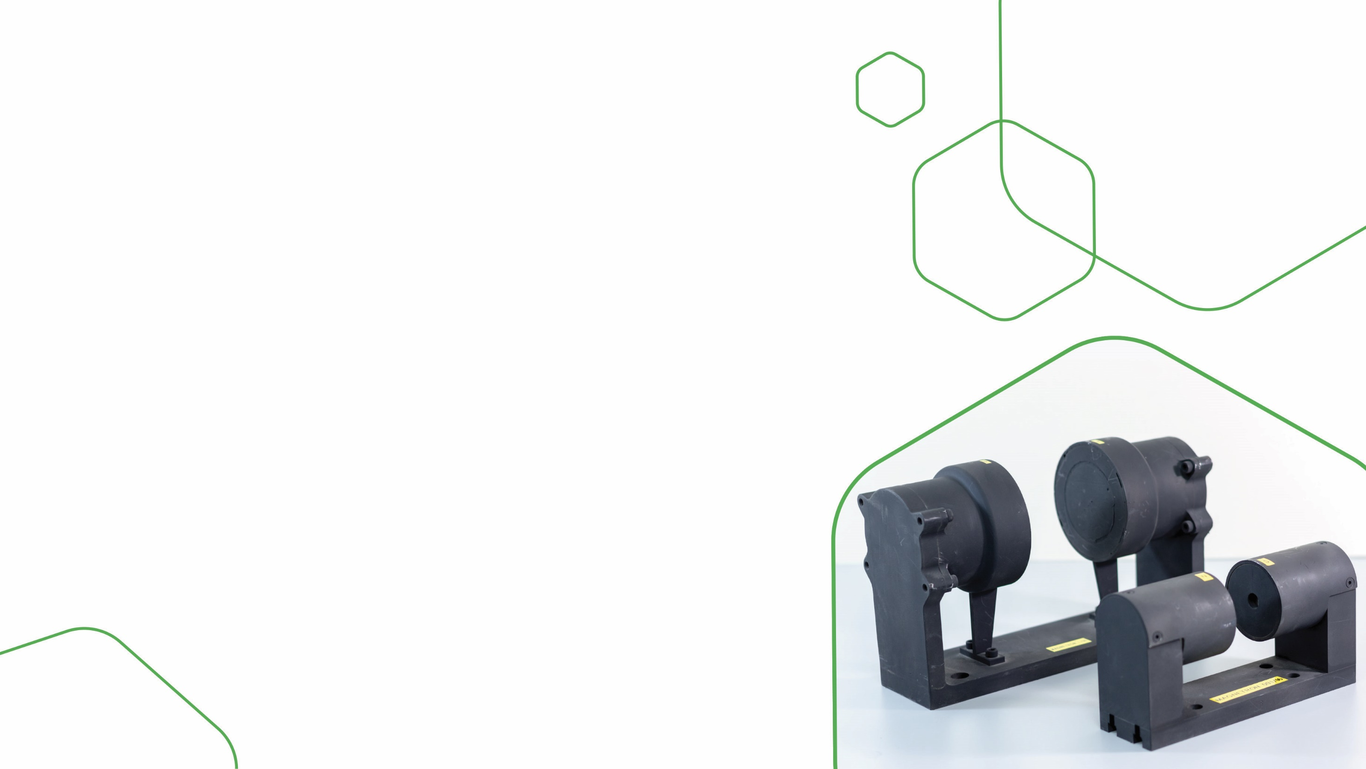
Homeland
Security
Customer 2
Challenge: an existing magnetic structure with a high-precision magnetic field was just too heavy.
Solution: Magma performed a magnetic analysis of the existing magnetic structure. A newly designed magnetic structure offered 40% reduction in weight, while maintaining the same high-precision magnetic field and same magnetic performance.

Slide 13
Automotive
Customer 1 (autonomous vehicle)
Challenge: a company developing a critical component for an autonomous vehicle requires support for a very small motor they plan to produce.
Solution: a magnetic simulation enabled the customer to move ahead with the very small motor under the main specifications required.

Slide 14
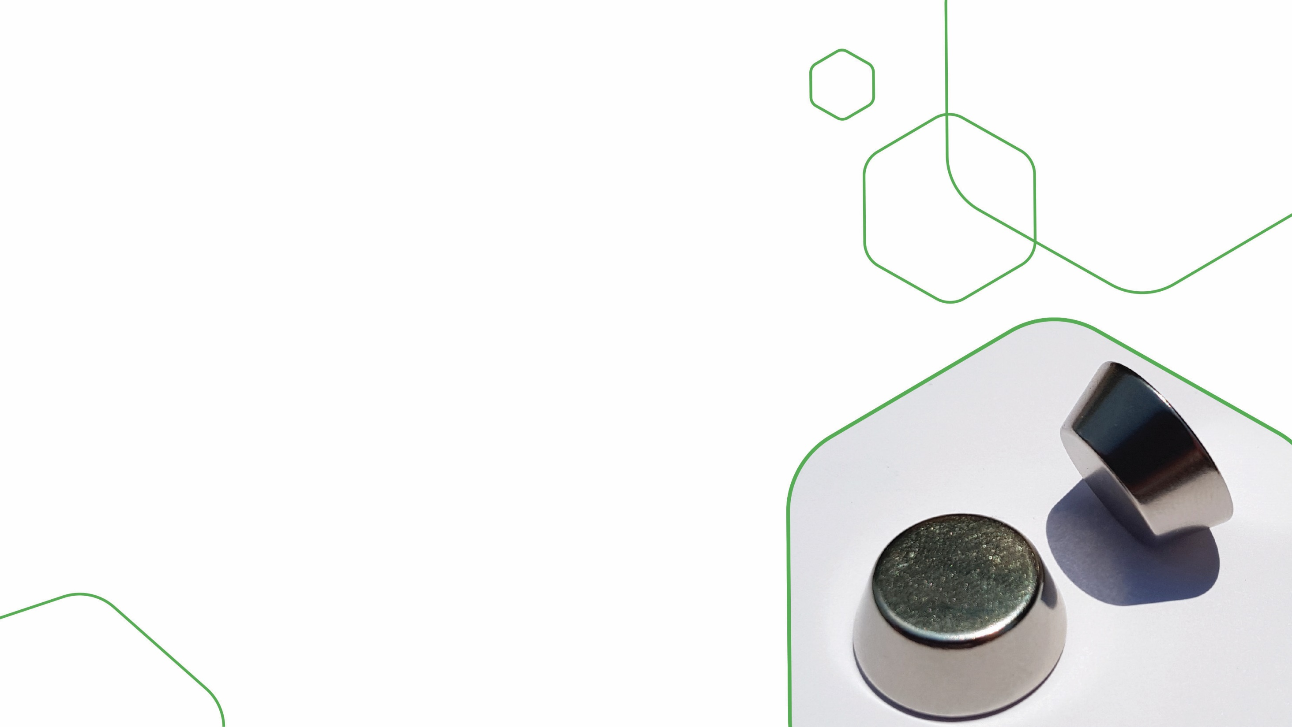
Automotive
Customer 2
(Plastics company)
Challenge: the customer encountered a problem in one of their van vehicles, in which the back door did not close hermetically.
Solution: Magma designed a specially shaped magnet, inserted into a plastic structure.

Slide 15
Consumer Goods
Customer 1
(water home machine)
Challenge: at the mass production phase, the customer experienced a failure due to deviations in both the plastic part and the magnetic design.
Solution: within two weeks, a solution was provided to keep the production line from halting; simultaneously, magnetic optimization was performed, resulting in a modified plastic part and redesigned magnet.

Slide 16
Consumer Goods
Customer 2
(Hermetically sealed pouch)
Challenge: a customer entered into a conflict with the manufacturer of his complete magnetic product.
Solution: in less than three months, an entire production line was set up for the product, with improvement and reduction in cost of the magnetic components.

Slide 17
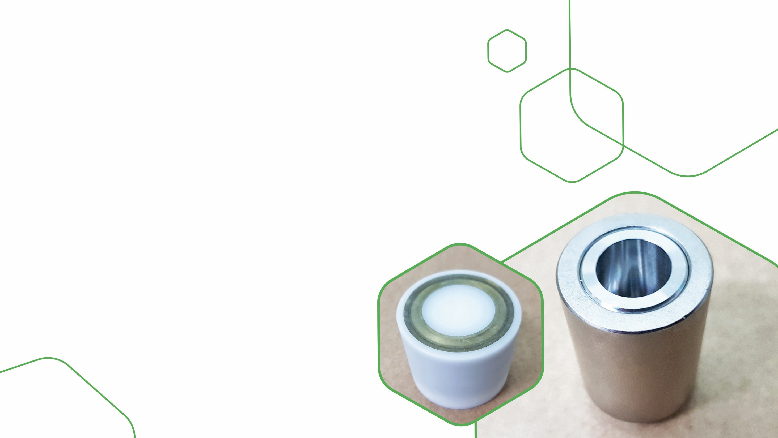
Consumer Goods
Customer 3
(Pool cleaning robot manufacturer)
Challenge: to create mechanical movement in a corrosive and harsh environment using a minimum amount of energy.
Solution: specific design and manufacture of a magnetic coupling based on a full radial ring inserted in a plastic cup, providing full protection against corrosion.

Slide 18
Looking forward to being your partner!
WEB: www.magmamagnets.com
SKYPE: magma.ceo
MAIL: trade@magmamagnets.com
PHONE: TEL: 972-50-5513013 / 972-722150592

